Slide 1
Data Structure

Slide 2
A data structure is a storage that is used to store and organize data. It is a way of arranging data on a computer so that it can be accessed and updated efficiently.
The idea is to reduce the space and time complexities of different tasks.
An efficient data structure also uses minimum memory space and execution time to process the structure.

Slide 3
A data structure is not only used for organizing the data. It is also used for processing, retrieving, and storing data. There are different basic and advanced types of data structures that are used in almost every program or software system that has been developed.

Slide 4
Need of Data Structure
The structure of the data and the synthesis of the algorithm are relative to each other.
Data structure modification is easy.
It requires less time.
Save storage memory space.
Data representation is easy.
Easy access to the large database

Slide 5
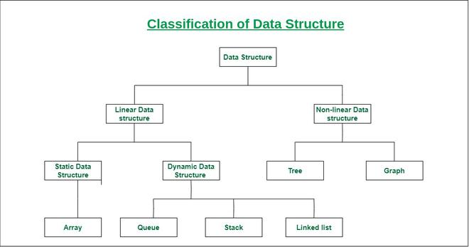

Slide 6
Linear data structure: Data structure in which data elements are arranged sequentially or linearly, where each element is attached to its previous and next adjacent elements, is called a linear data structure.
Examples of linear data structures are array, stack, queue, linked list, etc.
  Static data structure: Static data structure has a fixed memory size. It is easier to access the elements in a static data structure.
  An example of this data structure is an array.
  Dynamic data structure: In dynamic data structure, the size is not fixed. It can be randomly updated during the runtime which may be considered efficient concerning the memory (space) complexity of the code.
  Examples of this data structure are queue, stack, etc.

Slide 7
Non-linear data structure: Data structures where data elements are not placed sequentially or linearly are called non-linear data structures. In a non-linear data structure, we can’t traverse all the elements in a single run only.
Examples of non-linear data structures are trees and graphs.

